Slide 1
Welcome to
Miss. Harrison’s Classroom!

Slide 2
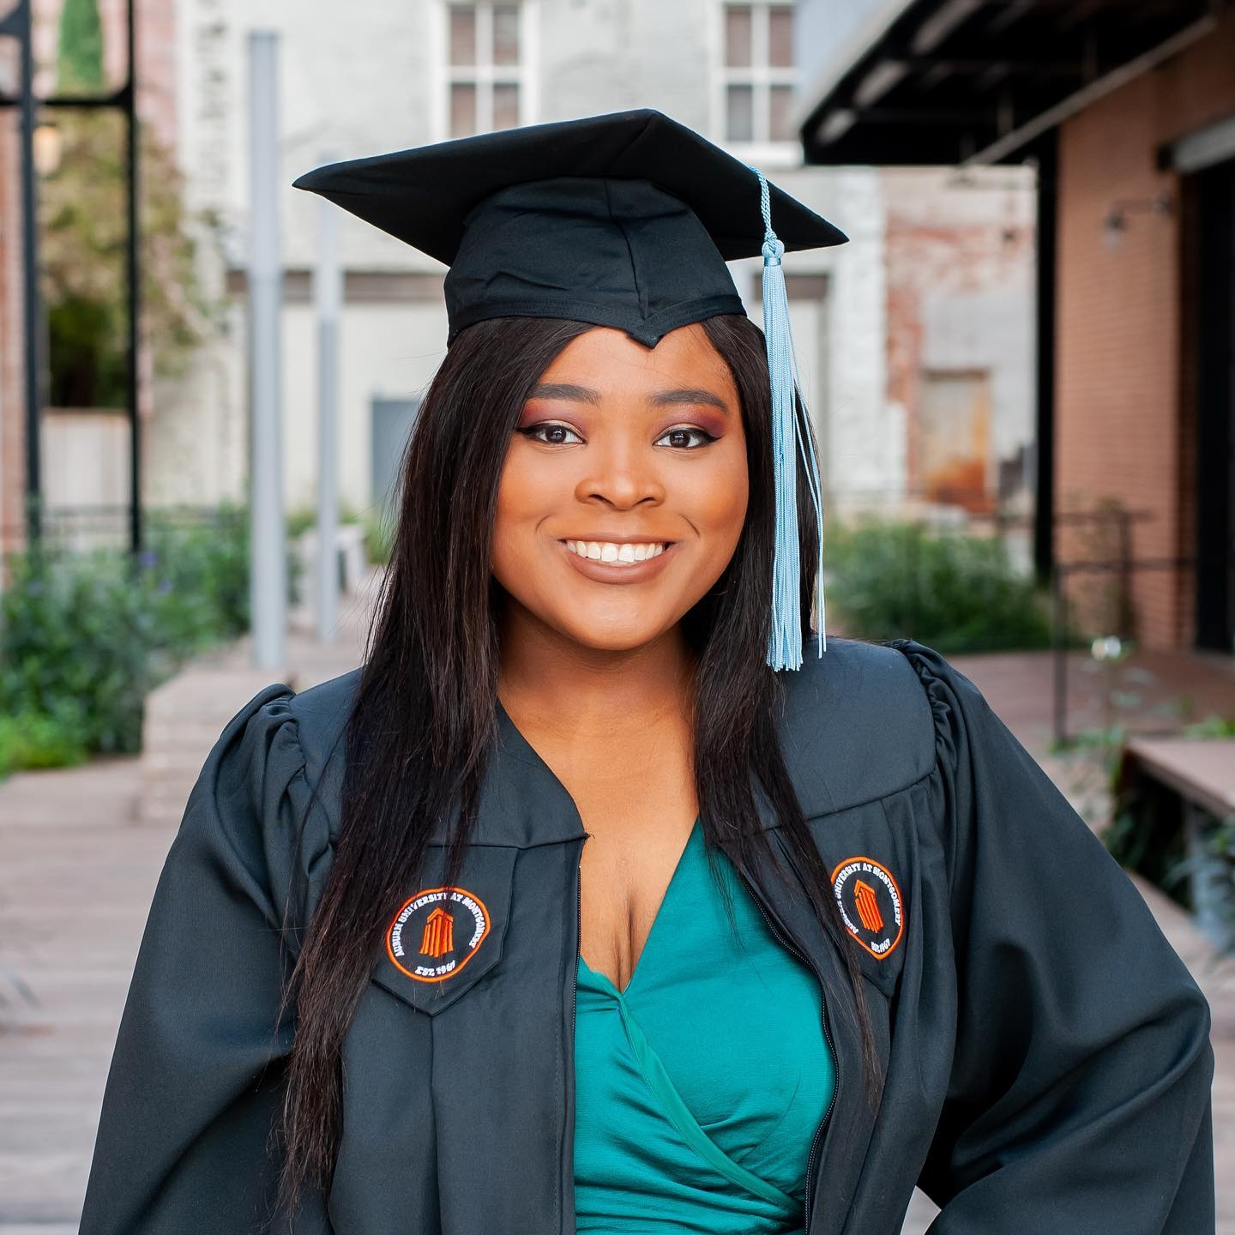
Meet the Teacher!
Rolanda Harrison
Graduated from Auburn University at
Montgomery
Currently lives in Montgomery
First Year teaching at Troy Elementary
School
I enjoy reading, binge watching Netflix,
and spending time with my family.

Slide 3
Classroom Expectations!
Students will be expected to follow all the school rules and class rules that are given.
Students will be expected to bring the school supplies that are on the School Supplies list. Be sure to label the supplies with the student’s name.
Students will be expected to bring back their take home folder everyday.

Slide 4
Classroom Expectations!
Even though students will not have to wear masks
in the classroom, they will be required to wear
masks walking from the car to the classroom and
when they move around the building. So, please
make sure your student has a mask on when they
arrive to school.

Slide 5
Arrival and Pick-Up!
This year, students may be dropped off at 7:30 AM and they will head straight to their classroom. Make sure your child is wearing their mask when they walk in.
Sack breakfast will be provided for students at the door.
Temperatures will be checked before the student enters the classroom.
8:05 will be considered tardy for students, so make sure they arrive with enough time to eat breakfast.
If your student does not show up for that day, please leave an excuse for the time missing in their take home folder or the absent will be unexcused.

Slide 6
Arrival and Pick-Up!
Pick up time for students will start at 2:20 and they will need to be picked up by 2:50
Make sure you fill out how your child will be dismissed on the Student Information sheet.
If you decide to change how your child will be dismissed , please leave a note in that child‘s take home folder.
There will be no after-school care this year.

Slide 7
Nurses!
Please do not send your student to school if they are sick. If your child is showing signs of COVID , please consult your doctor before sending them to school.
If your student has medicine that needs to be taken , make sure you fill out the appropriate forms and give to the nurse. Contact nurse: (334)-566-1444

Slide 8
Nurses!
It is policy for the nurse to call if your child needs to be picked up so please provide a current phone number on the Student Information sheet.
If your child is called to be picked up, please have them picked up as soon as possible.

Slide 9
Breakfast/Lunch/Snack!
Breakfast and lunch are free for every student this year.
Snack must be sent from home. We will not sell snack this year.
The water fountains will be disabled, so
students can bring their own water bottles.

Slide 10
Newsletter!
Newsletters will be sent home every Monday.
What the students will be learning throughout the week will be on the newsletter.
Upcoming tests and other important information will be listed on the newsletter.

Slide 11
Homework!
Students will be given homework every Monday with their newsletter.
The homework will be in the students take home folder.
Students do not have to bring back
homework , but it is suggested to be done
so that students can practice what they
have learned.

Slide 12
Tests!
Math tests will be given every Friday.
Math fluency tests will be given twice a week.
Each fluency test will be timed for three minutes.
The difficulty will increase as the year goes on.
Spelling and in reading tests will be given
every 6-7 days.
-The spelling words will be attached to the
newsletter that is given every Monday.
If a student misses school on the day of
a test , the student will have to make up the
test the day they come back.

Slide 13
visitors!
Students will not be able to have visitors this year.
For birthdays , parents will be unable to bring things for the class.
However, on Holidays and other special days, I will be able to bring treats for students.

Slide 14
Class Dojo!
Class Dojo will be used as our behavior management system this year.
Please be sure to sign up to keep track of your child‘s behavior throughout the week. The website is free, and Class Dojo can also be downloaded on your phone.
Class Dojo will be a great way for
me to virtually report your child’s
behavior and be an easy way for us to
communicate .

Slide 15
Contact Me!
Email: harrisonr@troyschools.net
School Number: (334)- 566 – 1444 ext: 3101
Planning period is 3-3:30.
You can also send a note with your student.

